Slide 1
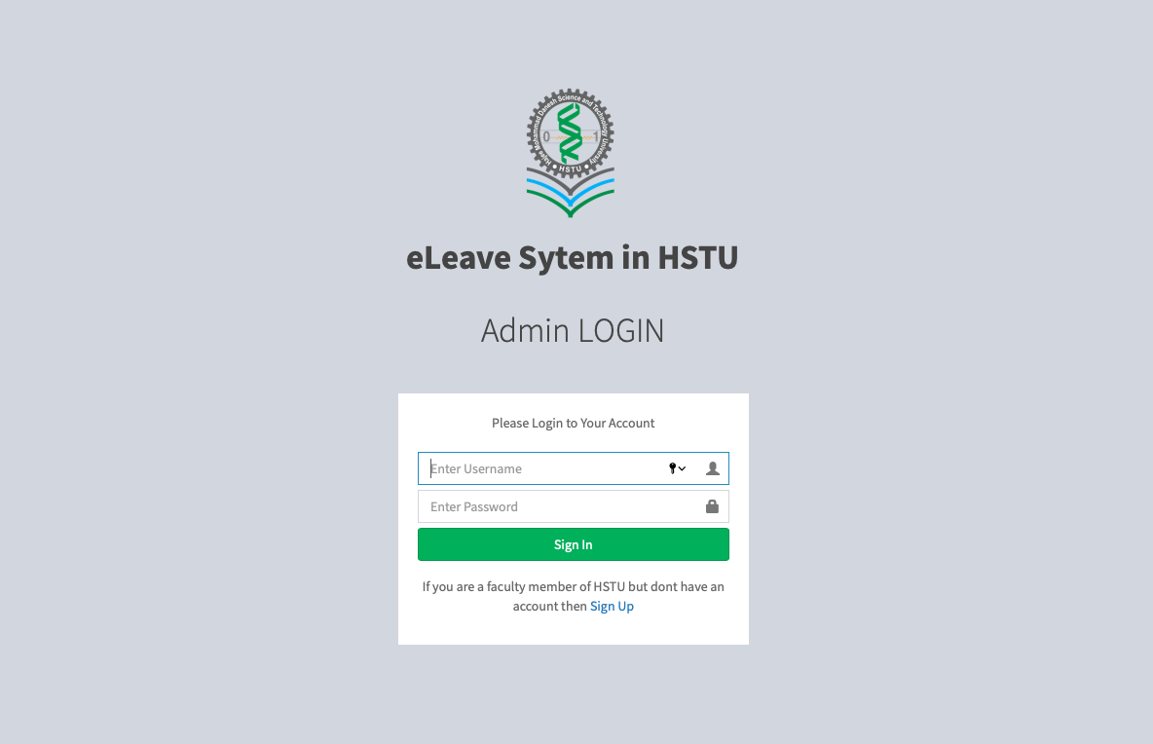
Teachers’ Online Leave Management System For HSTU
A Leave Management System Developed By
INTRODUCTION
Md. Rayhanur Rahaman Rubel
Department of ECE Hajee Mohammad Danesh Science & Technology University, Dinajpur

Slide 2
A leave management software developed for HSTU
Provides tracking of leave applications and realtime reports
A web based system for easy and remote access
For easily managing and processing the leaves of the teachers
Fully compatible with HSTU academic & Administrative system
OVERVIEW
To develop an automated leave management system for HSTU
To develop a digital system without changing the current administrative system
To remove the paper works from the leave management system
To reduce the complexity of manual leave management system
To track each and every activities going through the system
OBJECTIVES

Slide 3
Users Involved In Leave Processing
How Users Join Our System
Teachers DB of HSTU
Academic Users
Teacher
Chairman
Dean
Teacher
Administrative Users
Honorable Vice Chancellor
TECHNICAL SUMMARY
Registrar
Our Software
Deputy Registrar
Assistant Registrar
Deputy Director
Assistant Director
Assistant Administrative Officer
Administrative
User
Main Admin
Section Officer
Computer Operator

Slide 4
Submit For
Recommendation
Docket
Chairman
Dean
Application
Recommend
Recommend
Deputy Director
Assistant Director
Registrar
Mark
Mark
Recommend
VC
Memorandum
Collection
Own
Dept.
Approve
Mark
Docket
Section Officer
Computer Operator
PROCESSING WORKFLOW
Approve or Deny
Mark
Deputy sends to Registrar For Signature
Memorandum Assign
Office Order
Assistant Administrative Officer
Desk Pass
Registrar Signs
File Note

Slide 5
Registrar reviews the application, gives docket if necessary and forwards to a particular user of a particular designation. Application gets Docket of Registrar.
Deputy Director forwards the application to a Computer Operator for generating Office Order.
The Registrar then forwards the application to honorable vice chancellor for approval.
Teacher writes the application on the system and submits to chairman. Application contains Departmental Memorandum, days and type of the leave
After all the checkings the application is forwarded back to the Registrar.
The office order is assigned to the application and the Deputy Director checks it. If it is ok then Deputy director assigns the memorandum and forward to registrar for finalization.
Honorable vice chancellor either approve or declines the application.
DEAN
They are the Variable Users. Any user of a designation may accept forwardings, process them and forward them to another for further checking.
CHAIRMAN
REGISTRAR
Computer Operator writes the Office Order on our software, edits and submits it to the deputy director.
If application was approved by honorable vice chancellor then registrar forwards the application to Deputy Director for Office Order.
Dean reviews the application and Recommends to Registrar. Application gets Dean’s recommendation.
VICE CHANCELLOR
APPLICATION MECHANISM
TEACHER
Leave Application
Chairman reviews the application and Recommends to Dean. Application gets chairman’s recommendation.
LEAVE CONFIRMED
Designation A
User 1
The registrar checks the office order and finalize the leave. This is the last action and if the leave is finalized then the completed application is available to the respective teacher, chairman, dean, dean office in-charge with the office order.
Teacher starts his leave online and from the day he started his leave, the leave will be counted. Until then he is considered as “ON LEAVE”
OFFICE ORDER
Designation X User X
Designation A User 2
COMPUTER OPERATOR

Slide 6
VC & Registrar
All of his forwarding and approvals
Dean
All of his forwarding and approvals
Chairman
All of his forwarding and approvals
All the teachers of HSTU
All teachers currently on leave
When leaves of all teachers will expire.
All teachers of his faculty
Teachers of his faculty currently on leave
When the leaves of the teachers will expire
All teachers of his Department
Teachers of his department currently on leave
When the leaves of the teachers will expire
Teacher
Administrative Users
All of his drafts, processing, confirmed applications
Application’s current status
Leaves he has taken
All of his forwarding
All applications went through him.
REPORTS
Server Side Language 1. PHP
2. SQL
3. XML
Backend Framework
1. Slim Microframework
Client Side Language 1. JavaScript
2. AngularJS
3. Ajax
4. JSON
4. HTML
5. CSS
Database Used 1. MySQL
Teachers’ Database of HSTU
1. MySQL
ENVIRONMENT

Slide 7
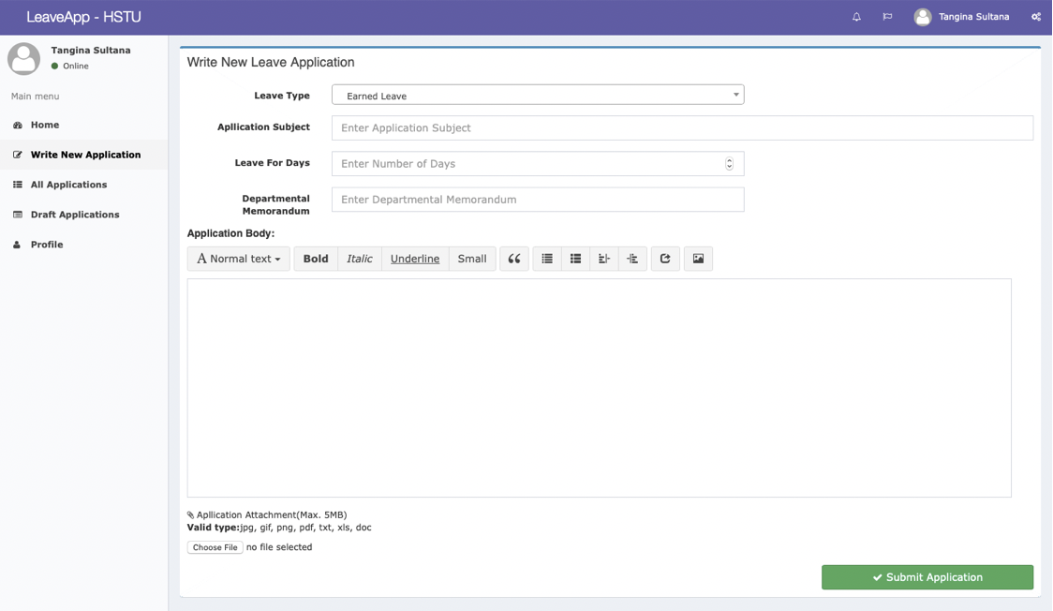
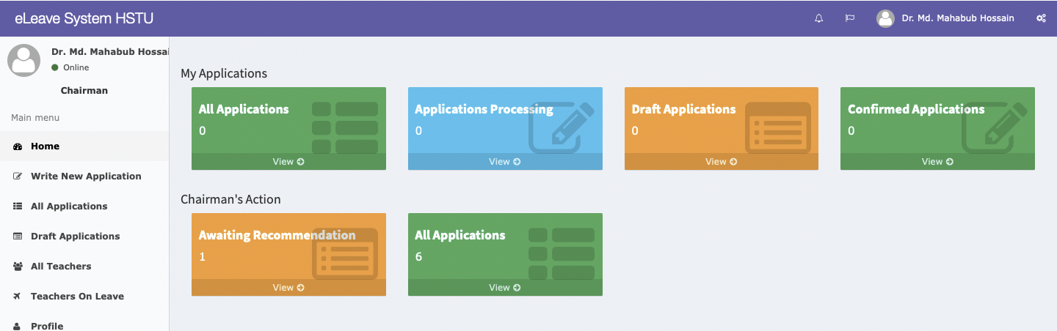
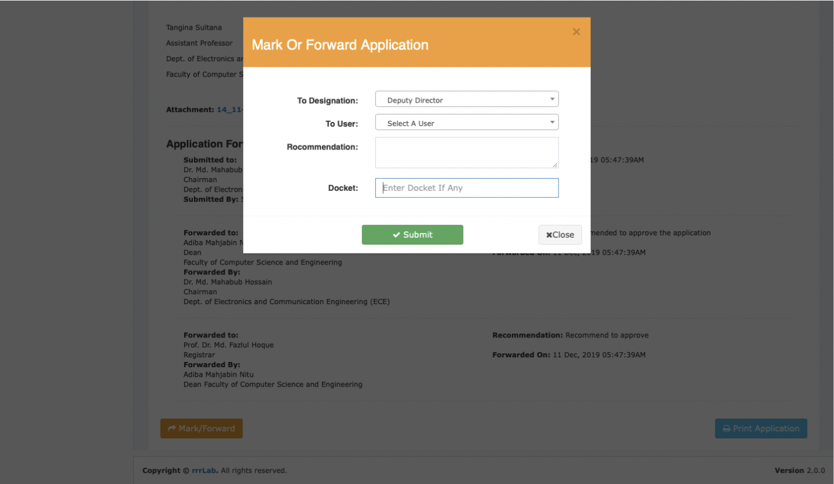
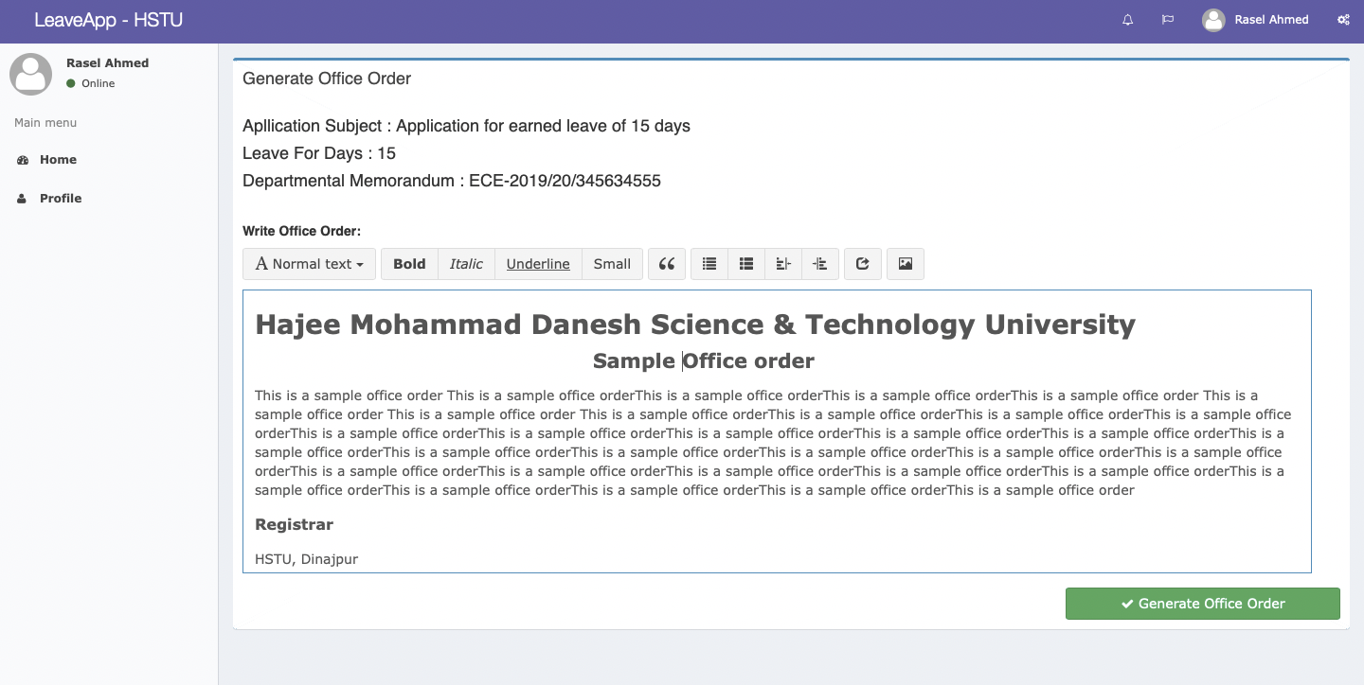
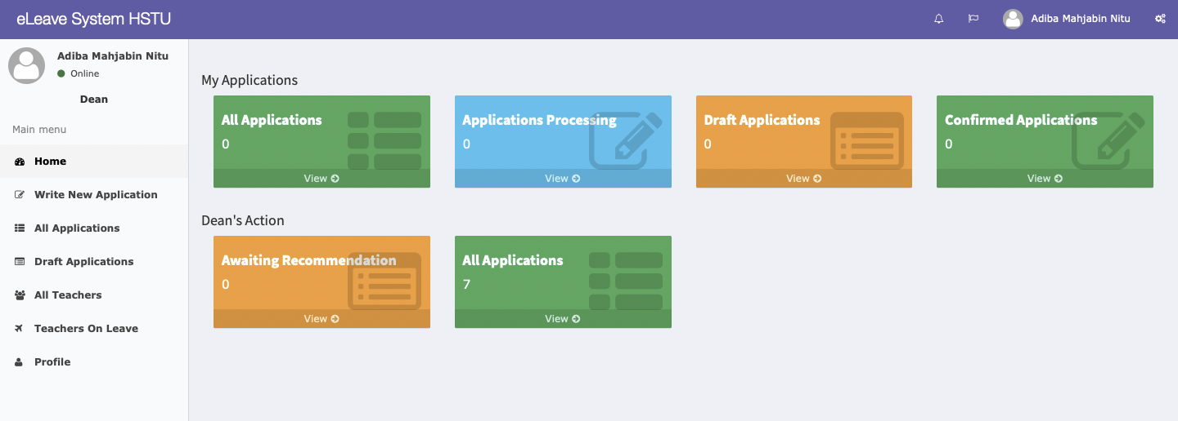
OUTPUTS

Slide 8
That’s all
Thank You for watching
Dependency on manual processes as the interrelated systems are manual
Best benefit comes when the whole system becomes digital
CONCLUSION
Further features implement
Make more user-friendly
Include administrative officers and employees’ leave system
Remove all possible issues from the software
FUTURE WORK

